Slide 1
Unit III Engineering Materials
Topic: conducting polymers
Dr. P. G. Umape
Department of Applied Science
Pune Institute of Computer Technology

Slide 2
Learning outcomes
Students will be able to

Slide 3
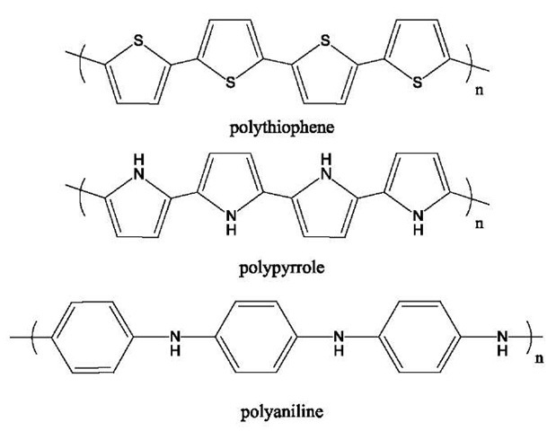

Conducting polymers
Eg.: Polyacetylene, Polyaniline, polythiopene
Types: Intrinsic & Extrinsic
Structural Requirement:
Planar & highly crystalline,
Linear
Presence of conjugation (free mobile electrons)
Doping: Polymer has to be disturbed - either by removing electrons from (oxidation), or inserting them into (reduction) into the material.
There are two types of doping:
p-doping: Oxidation with halogen
(positive charge developed on polymer)
n-doping: Reduction with alkali metal
(negative charge developed on polymer)

Slide 4
Conducting polymers
2(CH)_{x} + 3 I₂ 2 (CH)_{x}⁺ I₃⁻
Polyacetylene Iodine p-Doped polyecetylene
2(CH)_{x} + FeCI₃ 2 (CH)_{x}⁺ FeCI₄⁻ + FeCI₂
Polyacetylene p-Dope polyecetylene
(CH)_{x} + Na (CH)_{x}⁻ Na⁺
Polyacetylene Sodium n-Doped polyecetylene

Slide 5
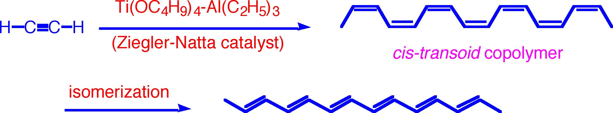
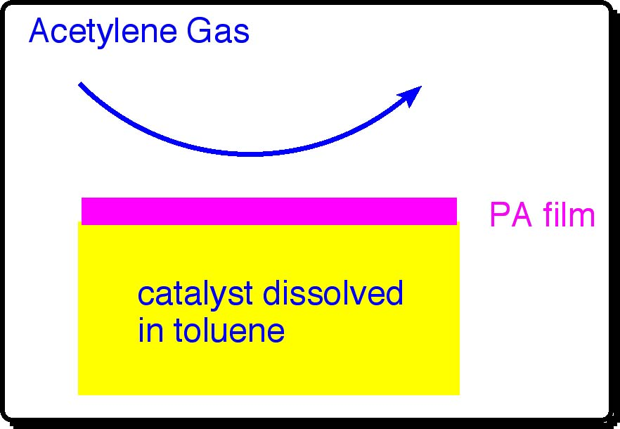
Conducting polymers
Synthesis of Polyacetylene
By Ziegler-Natta Catalyst
Effect of Temperature:
At -78 °C or below: all-cis PA
At 180 °C or higher: all-trans PA

Slide 6
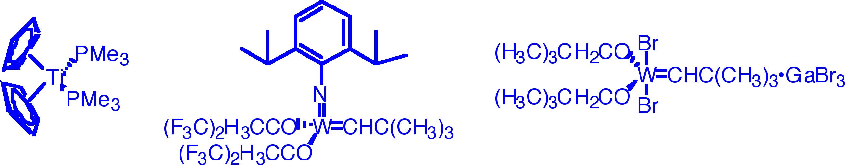
Conducting polymers
Polymerization by Other catalysts
Acetylene
PA
Catalysts:
WCl₆/(C₆H₅)₄Sn
WCl₆/n-BuLi
MoCl₅/ (C₆H₅)₄Sn
Note: These conjugate polymers are usually insoluble in organic solvents of have very low solubility

Slide 7
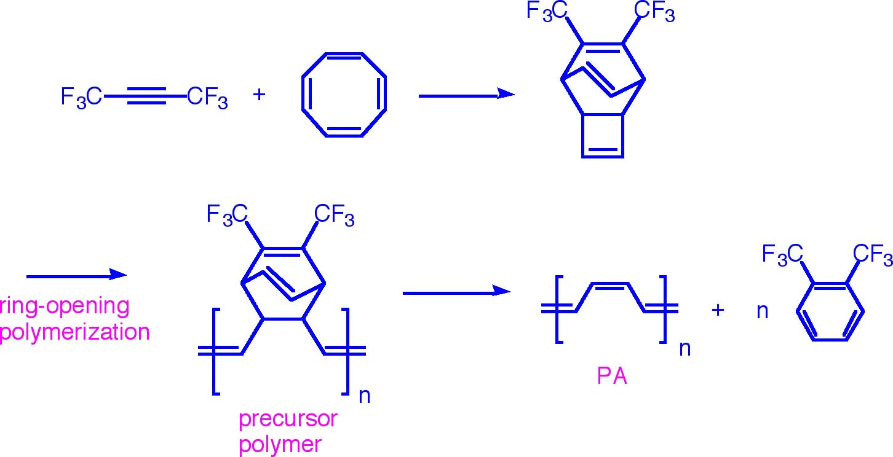
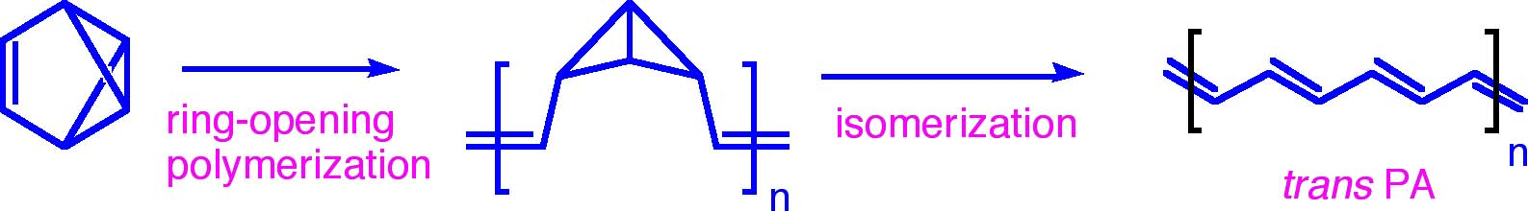
Conducting polymers
Durham Method
Isomerization of Polybenzvalene

Slide 8
Conducting polymers
Properties
Electrical conductor
Conductivity increases with doping
High thermal stability
Insoluble in solvents

Slide 9
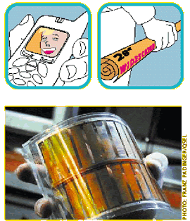
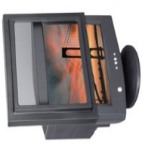
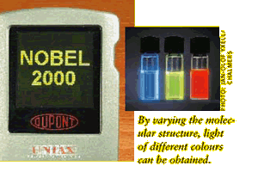
Conducting polymers
Applications of conducting polymers:
Rechargeable Batteries
As antistatic material
Optical filters
Sensors
In electronics (LED)
Photovoltic cells
Telecommuniction systems
Molecular switches
Solar cell
Light-emitting diodes

Slide 10
summary

